Slide 1
設計電力の理解
2025.2

Slide 2


目的
この章では、次の項目を学習します。
目的 01
デザイン電力の種類のリスト
目的 02
消費電力クロージャとデバイス選択の重要性の理解
目的 03
より良いタイム トゥ マーケットのために電力クロージャー フロー
目的 04
デバイスの電源をオフにする方法の特定

Slide 3
消費電力の意識
消費電力はボードのデザインに影響を与える; 各レールに十分なクリーン電力を確保する
絶対的なパフォーマンスを評価する必要がある
XPE は、より有能なツールを後で利用できるようにして、早期の消費電力推定を提供する
デザイン クロージャは、目標を達成するためにデザインのすべての側面を制約する
3 つの主要な柱:
  ビヘイビア: デザインはスティミュラスにどのように反応するか?
  タイミング: デザインの全体的なパフォーマンスとデバイス内の信号の動きはどのくらいか?
  消費電力: 仕事を遂行するためにどのくらいの電力が消費されるか?
推奨事項: 3 つの柱を同時に解決して、より迅速なタイム トゥ マーケットを達成する
Notes:
Power closure impacts board design from the standpoint of ensuring that the device is getting sufficient clean power for each rail as well as getting rid of the heat produced by the device. This is not, however, a strict board issue as a designer now has a tremendous amount of flexibility in deciding what computations get performed where.
The decision regarding where processing occurs is a system architecture issue where absolute performance must be weighed against performance per watt and available resources.
Early power estimation is achieved using the XPE tool. As the design progresses, users can employ more capable power analysis tools.
Users who follow the traditional approach of closing timing on a design first and then looking at power spend more time in iterating until both requirements are met. Power awareness in the design closure approach is the process of properly constraining all aspects of your design to meet its stated goals.
While there are other aspects to design closure and constraints, the three primary pillars are behavior, timing, and power.
Behavior is how the design reacts to stimulus; that is, does it do what it’s supposed to do?
Timing is comprised of two sub-elements: the overall performance of the design and the movement of signals within the device relative to the setup and hold times.
Finally, power covers how much current is consumed to get the job done. Perhaps more critical to this realm is how much heat is produced and dissipated by the design running in the specified part.
AMD recommends solving these three pillars simultaneously to achieve faster time-to-market results.

Slide 4
消費電力に関する用語
トランジスタの漏れによる消費電力と、デバイスの通常動作に必要な回路
ユーザー デザインのダイナミック消費電力
瞬間的なものであり、各クロック サイクルで変わる
電圧レベル、使用されるロジック リソースおよび配線リソースによって左右される
デバイス内部で消費される電力
  スタティック消費電力 +
  デザインの消費電力
熱消費電力とも呼ばれる
デバイスのスタティック消費電力
デザインの消費電力
オンチップの総消費電力
電源からデバイスの電源ピンを介して I/O が消費する電流（主に出力)
デバイスに最初に電源を投入したときに発生する過渡電流
各電源電圧で変わる
デバイスの構造によって異なる
オフチップ消費電力
パワーオン電流
Notes:
Let’s review some power terminology.
Device static power is the power from transistor leakage on all connected voltage rails and the circuits required for the device to operate normally, post configuration.
Design power is the dynamic power of the user design due to the input data pattern and the internal design activity. This power is instantaneous and varies at each clock cycle. It depends on the voltage levels, logic, and routing resources used.
Total on-chip power is the power consumed internally within the device, equal to the sum of device static power and design power. This is also known as thermal power.
Off-chip power is the current that flows from the supply source through the device power pins, then out of the I/Os and dissipated in external board components. The currents supplied by the device are generally consumed in off-chip components, such as I/O terminations, LEDs, or the I/O buffers of other chips, and therefore do not raise the device junction temperature.
Power-on current is the transient current that occurs when power is first applied to the device. This current varies for each voltage supply and depends on the device construction as well as the ability of the power supply source to ramp up to the nominal voltage.

Slide 5
デザインの消費電力 - 2つの部分の合計 (ダイナミックおよびスタティック)
ダイナミック電力
スタティック消費電力
以下に直接関係する:
ユーザーのデザイン
使用されるリソース要素の数
クロック周波数
イネーブルとトグルレート
ジャンクション温度に依存
report_power コマンドは、標準スタティック消費電力および最大スタティック消費電力をモデル化する
全体的な消費電力を削減してジャンクション温度を下げる
  熱ソリューションを改善するか、低電圧デバイスを選択する
Notes:
When considering the total power of a design, there are two critical parts: dynamic power and static power.
Dynamic power is directly related to the design that the user has created, the number of resource elements used, the clock frequency, and enable and toggle rates. All these contribute to the dynamic power of the design.
Static power, which is often overlooked, is all dependent on the junction temperature of the device. Static power will increase as junction temperature increases.
The report_power command models two types of static power: typical and maximum. Maximum static power should always be used for worst-case analysis.
Reduce the junction temperature to reduce the overall power. One way of doing this without impacting the design is to improve the thermal solution or select a low voltage device. However, these decisions need to be made early in the design cycle for best improvement.

Slide 6
消費電力クロージャ – 重要性
デザインは消費電力、供給、タイミング、ピン配置の制約に準拠する必要がある
総消費電力を制約する為、最大周囲温度と
θJA を提供する
FPGA/アダプティブ SoC デバイスのプログラマビリティとその他のオプションは、消費電力に問題がある場合に役立つ
消費電力を削減するために配置配線を再実行するには、タイミング クロージャと機能検証を再実行する必要がある
消費電力を削減するための最も望ましくない選択 は、製品の最終仕様を削減することである
  パフォーマンス: システムクロックを削減する
  機能: ロジックを削減する
デザインの変更
ボードのリスピンが必要
完了までに数か月かかる
変更には次のものが含まれる場合がある:
  より高いデザインの消費電力を満たすように電力分配を調整する
  追加の電力を消費するために熱ソリューションを改善する
ハードウエアの変更
Notes:
After the board design is fixed, ensure that the design stays within the constraints identified for power, power delivery, timing, and pinout for the design to meet your requirements. Constraining the design for total power and providing maximum ambient and theta JA for the most accurate estimation is recommended.
Typically, power and thermal issues take a long time to correct. One of the many benefits of FPGA and adaptive SoC devices is the programmability, and there are also other options available when power is a problem. These options include design changes and hardware changes
Let’s look at design changes first.
Re-running place and route for lower power may or may not work as this requires re-running timing closure and functional validation. Users often have to go further down the implementation flow and make changes to their HDL itself.
The final and least desirable option to reduce power is that users can opt for reducing the final specifications of the product—in either performance (such as reducing the system clock) or in features (by removing logic).
None of these changes are desirable but can be the quickest resolution. However, this can still take several weeks to make the changes and get a design within the power budget and then to re-run timing closure and functional validation.
Hardware changes require a board re-spin, which typically takes months to complete. Some of these changes would be around adjusting the power delivery to meet the higher design power or improving the thermal solution to dissipate the additional power.
There is no simple resolution for a power problem, and you may still have a design that requires high power. So, the earlier you identify it, the faster it can be resolved.

Slide 7
デバイスの選択 – スタティック消費電力への影響
デバイスはデザインのスタティック消費電力に影響する可能性がある
スタティック消費電力は電圧にも直接関係する
デザインの総消費電力を最小限に抑えるには、
デバイスを正しく選択することが重要である
(可能な限り低電圧デバイスをターゲットにする)
Notes:
Static power and total power cannot be discussed without talking about the impact of device selection, since a device can contribute to the static power of a design.
Static power is also directly related to the voltage the device is running on. Ensuring correct device selection is critical to ensuring the lowest total power of a design.
So, a low voltage device should be targeted wherever possible.
If timing closure is difficult at low voltage, it is easier to move from low to mid or nominal voltage and take advantage of the speed increase. But if there is a power challenge later in implementation at medium or nominal voltage, it is not so easy to move to a lower voltage.

Slide 8
デバイスの選択 – スタティック消費電力への影響
Versal™ デバイスは 3 つの電圧で利用可能
Low @ 0.7v
コア電源
Mid @ 0.8v
コア電源
High @ 0.88v
コア電源
UltraScale+™ デバイスは同レベルの電圧選択を提供できないが、
一部のデバイスは Vlow @ 0.72v で利用可能
Notes:
The Versal device is available in three voltages: low @ 0.7v, mid @ 0.8v, and high @ 0.88v core supplies. The Versal device is also available in both a standard and low-static screen—allowing for further static reductions if needed.
UltraScale+ devices do not offer the same level of voltage selection, but select devices are available in low voltage (Vlow) @ 0.72v.

Slide 9
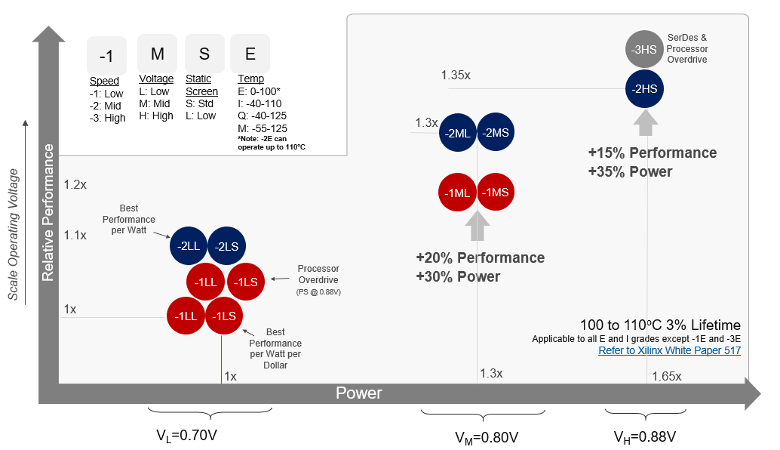
デバイスの選択 – スタティック消費電力への影響
-1 および -2 LL デバイスは、ワットあたり最高のパフォーマンスと、1 ドルあたりワットあたり最高のパフォーマンスを提供する
Mid電圧部品とHigh電圧部品が性能を向上する
消費電力は電圧とともに性能よりも速い速度で増加する
Notes:
This figure shows how Versal™ devices stack up from a power-to-performance perspective, with power on the X axis and performance on the Y axis. You can see that the -1 and -2 LL devices give the best performance per watt and best performance per watt per dollar. The mid voltage parts and the high voltage parts increase performance.
The key takeaway here is that power increases with voltage at a faster rate than performance, which really underscores the importance to select the lowest voltage device that can still meet your performance requirements.
If needed, it is easier to increase core voltage than it is to decrease it later in your design.

Slide 10
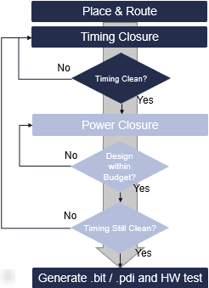

デザイン クロージャ – タイム トゥ マーケット
(タイミングおよび消費電力の組み合わせ)
従来のアプローチ: デザイン上のタイミングを閉じてから、電力を確認する
デザインの消費電力を計算する
Notes:
The traditional approach from designers is to close timing on a design first and then look at power.
Here, you can see that the flow starts from place and route. This is followed by report timing, which will typically iterate until a clean timing run is generated. Depending on the design and the Fmax, this can be quick, or it can be a time-consuming process.
Once the timing is clean, the next step is the power closure, where the total design power is calculated, and whether the design is under the power budget or not is checked. The next step after power closure is making sure that the timing for the design is clean again. Once the functionality is verified, and the design is checked for timing and power, designers will move on to generating the bitstream or PDI and hardware testing.
Then depending on how strenuous their functional testing is (for example, if they do temperature testing on multiple devices), they may or may not see a power issue and sign the design off.
However, running power closure on the best timing run might often be good for timing, but it is not optimal for power and might possibly not meet the power requirements. In this case, either the design changes or different directives would be run to get the design power closed, causing the design to be checked again for timing. You can see how this flow can lead to numerous iterations for both timing and power closure and ultimately increases the time to market.
So, let’s look at a more efficient design closure flow, where both timing and power are analyzed together.

Slide 11
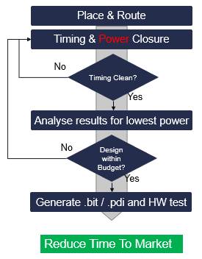

デザイン クロージャ – タイム トゥ マーケット
(タイミングおよび消費電力の組み合わせ)
タイミング run に電力を含める
タイミングと消費電力の両方の観点からデザインのイメージを構築する
タイミングと消費電力の両方の要件を満たす run が存在しない場合、タイミングと消費電力クロージャを再度実行する前に最適な run を選択してデザインを最適化する
より良い意思決定を可能にする
インプリメンテーションの時間とタイム トゥ マーケットを削減する
Notes:
The proposed flow is simple. Just include power into the timing runs. You would still run multiple runs, but you now run report power while analyzing timing. Unlike with the flow that was just discussed where you would proceed only when you have clean timing runs, you will now build a picture of the design from both the timing and power perspectives. This allows you to pick the run that best meets both requirements.
In a scenario where no runs meet both the timing and power requirements, you can pick the best run to try to optimize before running timing and power closure again.
This dual approach allows better decision making and reduces the implementation time, ultimately reducing the time to market.

Slide 12
タイミングと消費電力を組み合わせることでより多くの情報が得られる
デザインとデザイン run の可視性が向上
タイミングと消費電力の両方の観点から
最適な run を可能にする
Notes:
Power impacts every design and can have an outsized time-to-market impact if not addressed correctly.
The design closure approach of running timing and power analysis together gives better visibility into the design and the design runs. It allows you to take the best run from both the timing and power perspectives.
Let’s look at how powerful this approach can be.

Slide 13
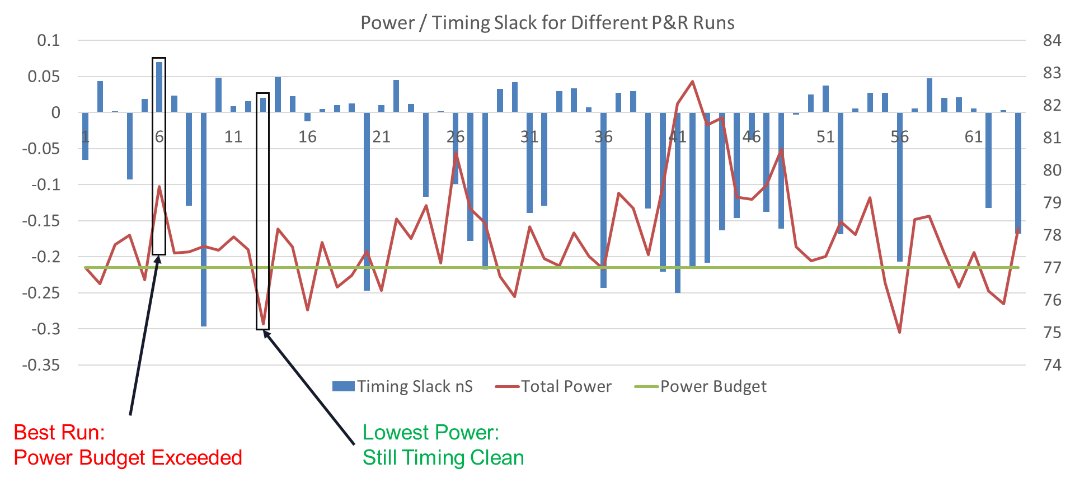
タイミングと消費電力を組み合わせることで、より多くの情報が得られる
Virtex™ UltraScale+™ HBM FPGA デザイン run ごとのタイミング スラックと総消費電力は、配置配線コマンドと指示子のさまざまな反復を通じて実行される
タイミングは 36 回の run でメット
Run全体 で 8W のスイング
目標電力バジェット77W
総消費電力バジェット未満のrunは15 回
run 13 は最低の総消費電力を持つ
Notes:
We ran one of our Virtex UltraScale+ HBM FPGA designs through different iterations of place and route commands and directives. The timing slack and total power were recorded for each run.
In the figure here, we have the run number on the X axis. The timing slack from the runs between 0 to 1.2ns pass timing. On the right, we have the total power in Watts.
Let’s look at the design’s timing slack first. We can see how the design has performed for various implementation commands—36 runs pass timing, so more than half. Using the traditional approach, the best run would be used to run report_power, but let's get the full picture before selecting the best run.
Next, let's look at the total power of each run. There is quite a difference across all the runs with a swing of 8W, which is about 10% of the total power—quite a significant difference.
The most critical element of this portion of the design analysis is whether it falls within the power budget. Typically, the budget is provided by the board design team after the thermal simulations to identify the maximum amount of heat that the product can dissipate into the operating environment.”
The power budget for this design is 77W. You can see that there are 15 runs that are below the total power budget. If we were using the traditional approach, we would probably take run 6, which has the best timing result. But if we look at the power, it is just over the budget. With the normal approach, we would spend time making design adjustments and more runs to bring down the power.
Now that we have the bigger picture, we can see 11 runs that have passed timing, albeit not by as much as run 6, and are timing clean. They also have power lower than the budget. We can now pick the best run from a power perspective that is also timing clean.
In this case, it is run 13 that has the lowest total power of all runs. However, its timing score is right in the middle. So, this run would not have been picked as the best run in the traditional timing-first-then-power approach.
This clearly illustrates the amount of data that can be generated by combining timing and power analysis into a single run—allowing you to pick the best run for both.

Slide 14
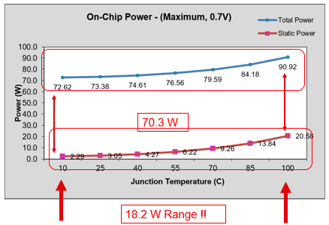
デザインの消費電力 – 例
ジャンクション温度の差で消費電力が大きく変わる
ダイナミック消費電力は同じ 70.3W
(総消費電力 – スタティック消費電力) = 70.3W
最大-最小 ＝ 18.2W の差
Notes:
Here you see the impact of static power on the overall design power.
From the graph, you can see the total power (shown in blue) and the static power (shown in red).
Total power has a range of 72 to 90W.
Dynamic power does not change over temperature. You can infer that the dynamic power is 70.3W by subtracting the static power from total power at the same junction temperature.
Looking at the static power, you can see a large variance from 10C to 100C—up to 18.2W.
When we look at total design power, understanding static contribution is critical to ensuring accurate power estimation.

Slide 15
消費電力/熱/ボードの設計手法
消費電力見積もり
熱設計
電力分配の定義
消費電力を削減できない場合、熱デザインとボード デザインを
やり直す必要がある
(非常に時間がかかる)
PDN の定義/シミュレーション
ボード/回路図チェックリストの定義
Vivado™ Design Suite での制約
デザイン
の変更
report_power の実行
分析
何がうまくいったか?
詳細は学べましたか?
いいえ
バジェット内
で設計しますか?
はい
すべての元の想定/デザイン制約が
満たされていることを確認する
成功
Notes:
The board design methodology starts with the initial power estimation in XPE. This is typically done before development in the Vivado Design Suite has started.
The results of this initial estimation are critical. They should be fed directly into a thermal simulation to model the complete application and ensure that the thermal solution can dissipate the estimated power.
The thermal results can be used to refine the estimation further, which then dictates the required power delivery solution and the maximum specifications of the regulators on the board, as well as the power decoupling network (PDN).
All of these impact the specifications of the board, and so they should be applied to the design in the Vivado Design Suite. This is where report_power comes in. As with any estimation, its accuracy is dependent on not only the models provided by AMD, but more critically on the inputs. These must be provided by the user.
It is this aspect that makes power closure different from the other design closure steps. One of the main steps users typically overlook even if they do run report_power is that they do not provide the correct inputs to make it accurate.
This gives you the bigger picture on where power closure lies in the board methodology flow to ensure a successful product the first time and ensure the quickest time to market.

Slide 16
バジェット内でデザインの消費電力を実現
消費電力が大きすぎる場合:
デザインの消費電力を削減する
熱に関するデザイン制約の熱ソリューションを改善する
ボードおよび熱ソリューションを改善する
デザイン内の機能の複雑性を削減する
Notes:
If the design power is too high:
Try reducing power in the design. This approach is the least time consuming.
You can try improving the thermal solution within the thermal design constraints. For example, change the heat sink composition to improve the thermal solution, such as adding heat pipes or forced air.
You can improve the board and thermal solution, if possible. However, be aware that thermal changes might increase the power in the design.
You can also try reducing the complexity or features in the design. For example, you can reduce power by reducing the clock frequencies, resources used, or toggle rates. You can use XPE for “what if” analysis to quickly estimate the impact of design changes.

Slide 17


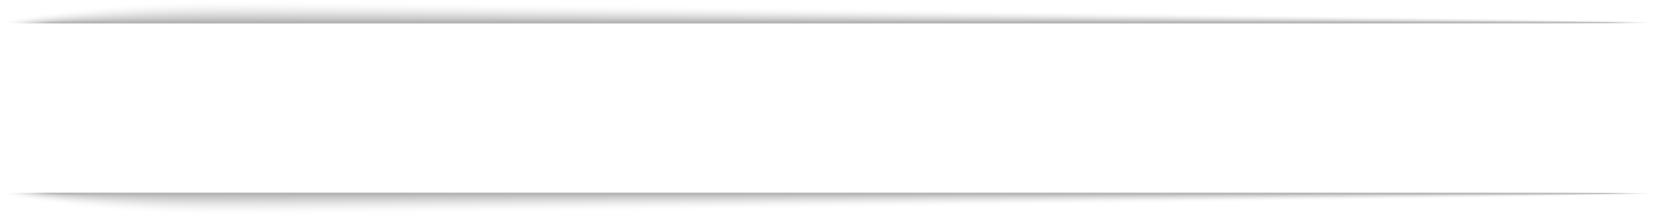

確認問題
消費電力クロージャのためのデザインの変更段階ではどのような手順に従う必要がありますか?
(正しい選択肢を全て選択してください)
配置配線を再実行する
HDL の変更
ボードのリスピン
電力分配の変更
Notes:
Correct answers:
Re-run place and route
Change HDL
Correct feedback:
Your response is correct.
Incorrect feedback:
The correct answers are:
Re-run place and route
Change HDL
Try again feedback:
Hint: Refer to the “Power Closure – Importance” slide.

Slide 18
確認問題
スタティック消費電力とジャンクション温度の関係は何ですか?
ジャンクション温度が増加するとスタティック消費電力が減少する
スタティック消費電力はジャンクション温度の影響を受けない
ジャンクション温度が増加するとスタティック消費電力が増加する
スタティック消費電力はジャンクション温度に反比例する
Notes:
Correct answer:
Static power increases as junction temperature increases
Correct feedback:
You selected the correct answer.
Incorrect feedback:
The correct answer is “Static power increases as junction temperature increases”.
Try again feedback:
Hint: Refer to the “Design Power – Sum of Two Parts (Dynamic and Static)” slide.

Slide 19
まとめ
01
デザインの総消費電力を考慮する場合、次の 2 つの重要な部分がある:
ダイナミック消費電力
スタティック消費電力
02
スタティック消費電力はジャンクション温度と電圧に依存するため、デバイスの選択が重要
03
動作、タイミング、電力を同時に解決して、より迅速なタイム トゥ マーケット結果を達成する
04
消費電力が大きすぎる場合:
デザインの消費電力を削減する
熱に関するデザイン制約の熱ソリューションを改善する
ボードおよび熱ソリューションを改善する
デザイン内の機能の複雑性を削減する

Slide 20
GENERAL DISCLOSURE AND ATTRIBUTION STATEMENT
The information contained herein is for informational purposes only and is subject to change without notice.While every precaution has been taken in the preparation of this material, it may contain technical inaccuracies, omissions and typographical errors, and AMD is under no obligation to update or otherwise correct this information.Advanced Micro Devices, Inc. makes no representations or warranties with respect to the accuracy or completeness of the contents of this material, and assumes no liability of any kind, including the implied warranties of noninfringement, merchantability or fitness for particularpurposes, with respect to the operation or use of AMD hardware, software or other products described herein.No license, including implied or arising by estoppel, to any intellectual property rights is granted by this document.Terms and limitations applicable to the purchase or use of AMD’s products are as set forth in a signed agreement between the parties or in AMD's Standard Terms and Conditions of Sale.GD-18.
©2023 Advanced Micro Devices, Inc. All rights reserved. AMD, the AMD Arrow logo, UltraScale+, Versal, Virtex, Vivado, and combinations thereof are trademarks of Advanced Micro Devices, Inc. Other product names used in this publication are for identification purposes only and may be trademarks of their respective owners.

